Slide 1
Strategic Market Entry Assessment – Panama
Client: Dajcom Limited Presented By : victor mekason Data Analyst Date: 8th June 2025

Slide 2

Executive Summary
Dajcom wants to enter Panama’s food and beverage market and needs data to make smart decisions
Panama has a mixed economy. Some regions like Panama city, colon and Chiriquí has more population and development, others don’t. Investment is uneven.
Key questions we answered:
Is Panama’s economy strong enough for us to enter now?
Which industries are growing and relevant to our business?
Where in Panama should we set up?
Key insight:
Enter Panama through a logistics-driven food and beverage strategy.
Base operations in Panamá Province and Colón (big cities with ports and trade).
Source products from Chiriquí (strong agriculture).
.

Slide 3
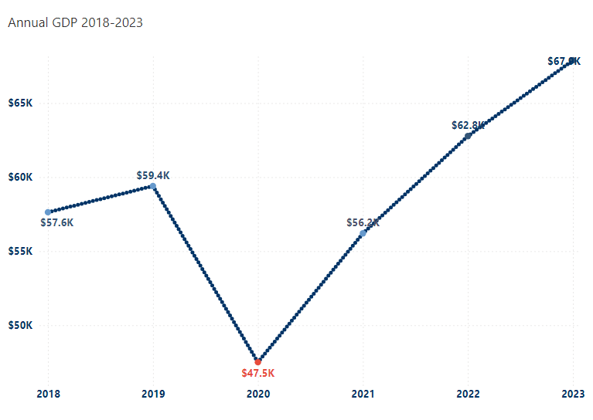
Panama’s Economy is Growing Strong After COVID-19 with GDP Growth +18% in 2021 and continues in fine form at Rate > 10% in 2022 -2023
Annual GDP from 2018–2023 with a drop in 2020 and strong recovery from 2021
GDP dropped -20% in 2020 due to (COVID19) but bounced back 18% in 2021 and 2022 with over 10% continued growth.
Recovery is driven by commerce, logistics, and construction.
Panama is in a strong position for Business entry in 2025, with room to grow.
Economy Rebounced Back with 18%
In 2021
Deep contraction due to covid19 -20%
In 2020

Slide 4
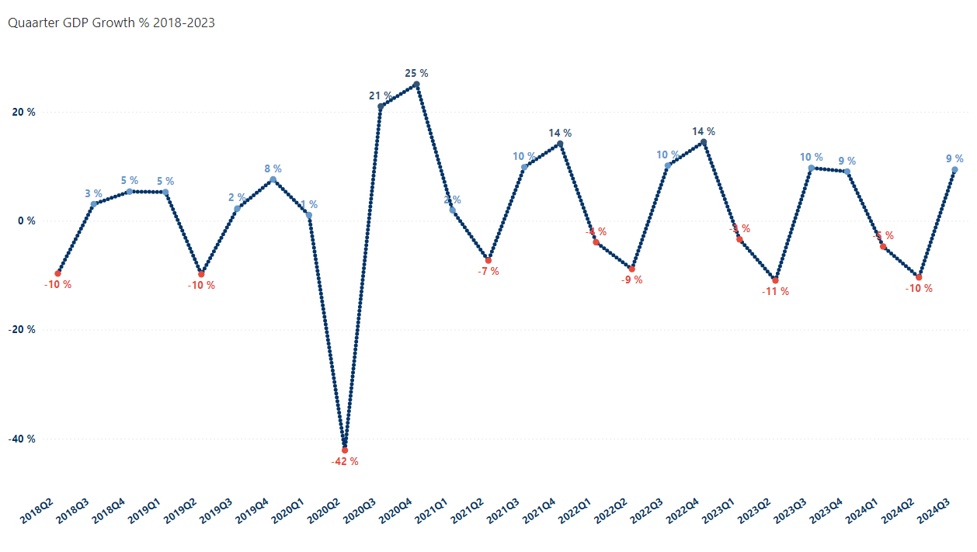
Panama’s Economy Rebounded Strongly After the COVID Crash
Economy Rebounded Strongly in 2020Q3
Data shows:
In Q2 2020, Panama's GDP dropped sharply by –42%, marking the deepest quarterly contraction in years — directly tied to the global COVID-19 lockdown.
The rebound was fast and powerful: GDP grew 21% in Q3 2020 and 25% in Q4 2020, reflecting a strong V-shaped recovery.
From 2021 to 2024, Panama maintained quarterly growth between 9–14% in most Q3 periods, but often saw Q1 and Q2 contractions, ranging from –7% to –11%.
Pattern observed:
Seasonal dips in Q1 and Q2 followed by strong growth in Q3, suggesting structural or seasonal business cycles (possibly due to trade flows, tourism, or investment patterns).
Despite the dips, the economy remains stable, and growth is returning to pre-COVID levels.
What this means for business:
The data confirms that Panama has weathered the worst and is consistently bouncing back. The pattern of mid-year dips followed by end-of-year spikes indicates the need for seasonal strategy planning — especially in sales, logistics, and investment timing. Businesses entering the market should prepare for Q1–Q2 volatility, while leveraging Q3–Q4 momentum for performance scaling.
Deep contraction in 2020Q2

Slide 5
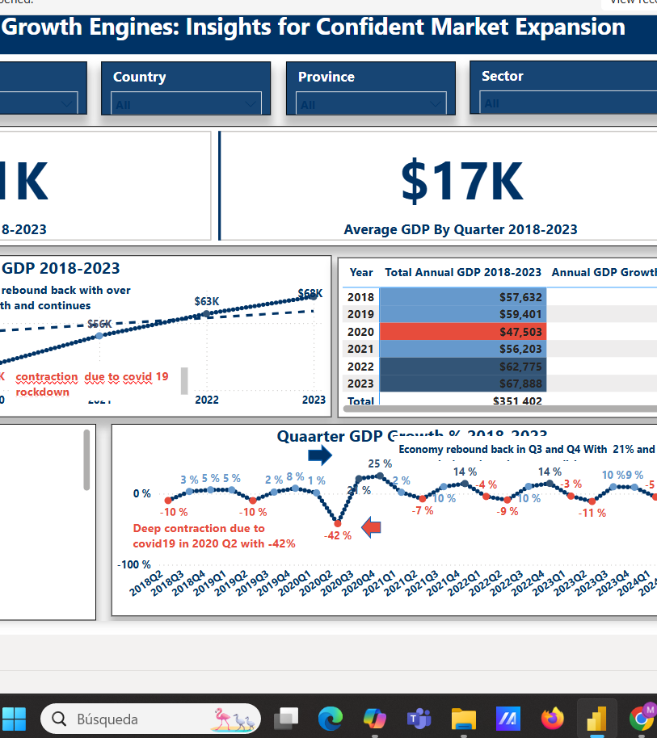
Panama’s Economy Is Back on Track with Post-COVID Recovery Momentum….
Data Insight:
Annual GDP reached $351k, with a quarterly average of $17k.
GDP has grown >10–12% annually since 2021 -2023.
Average quarterly growth >4%, reflecting a strong and sustained recovery after the 2020 contraction.
Panama has emerged from the pandemic with resilience. The country presents a stable economic environment ideal for market entry, expansion, and long-term investment.

Slide 6
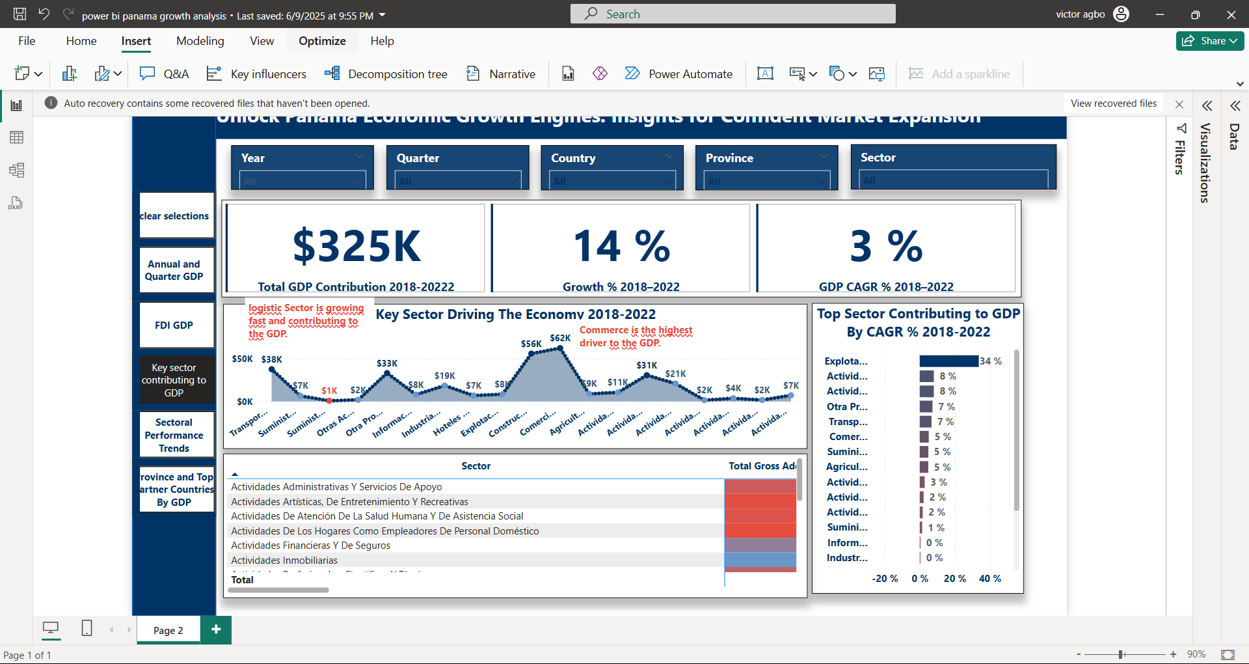
Retail, Logistics & Manufacturing Are Panama’s Growth Engines. GDP grows at rate 14% and CAGR 3% (2018-2023)
Data Insight:
Top 3 sectors by GDP contribution:
Wholesale & Retail: CAGR > 5%
Transport & Storage: CAGR > 7%
Manufacturing Food & Beverage related industries : Consistent perform CAGR > 4% (2018–2023)
These sectors show robust performance and consumer demand, offering high potential for partnerships, product distribution, and supply chain integration.

Slide 7
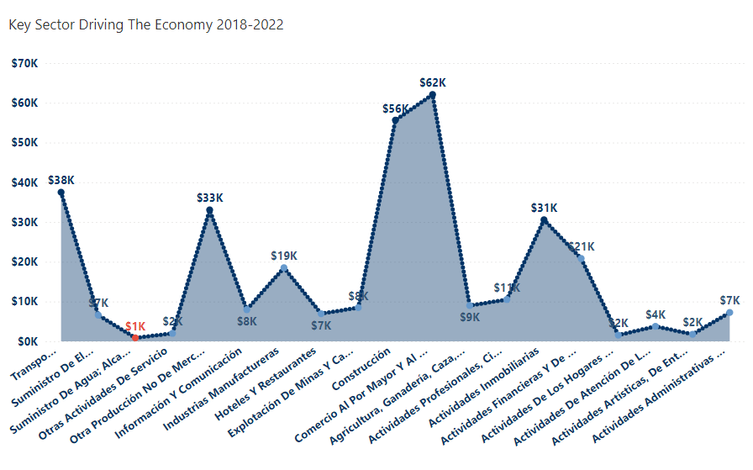
Strong Growth in Retails, Transport, and manufacturing
Top-growing sectors:
Transport & Logistics
Retail/Wholesale (Commerce)
Financial Services
Information & Communication (ICT)
These sectors match Dajcom’s strengths in distribution, retail, and manufacturing

Slide 8
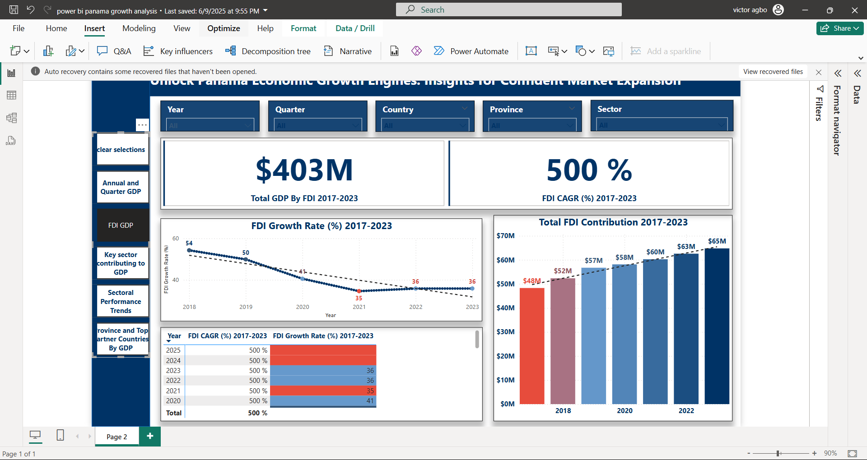
FDI Flows Are Concentrated in Logistics and Retail
Key Insight:
Retail &Highest FDI inflows (2020–2023) went to:
Logistics & Transport
Trade
Pre-COVID FDI growth in logistics: >10% YoY (2018–2019)
Construction and Financial Services also attract consistent investment.
High FDI signals policy stability, global investor trust, and the availability of critical infrastructure—supporting fast market entry and regional expansion.

Slide 9
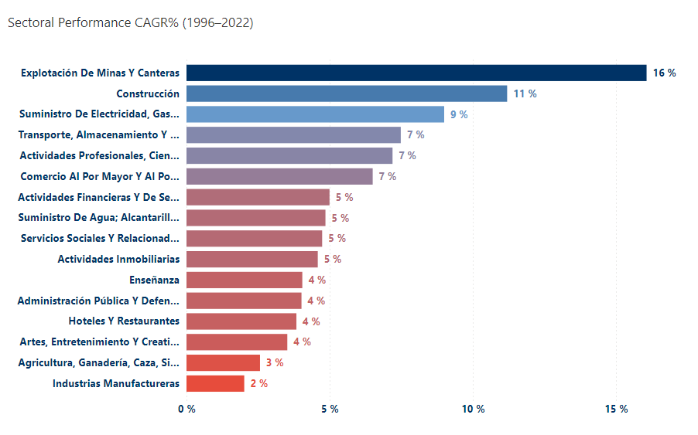
Foreign Investment Shows Confidence in Panama
What the data says:
Sectors like Retails, telecom, and logistic get regular foreign investment with CAGR% 7% Growth .
Food-related sectors are starting to attract more attention.
Panama’s economy is attractive for investors — especially in areas Dajcom cares about.

Slide 10
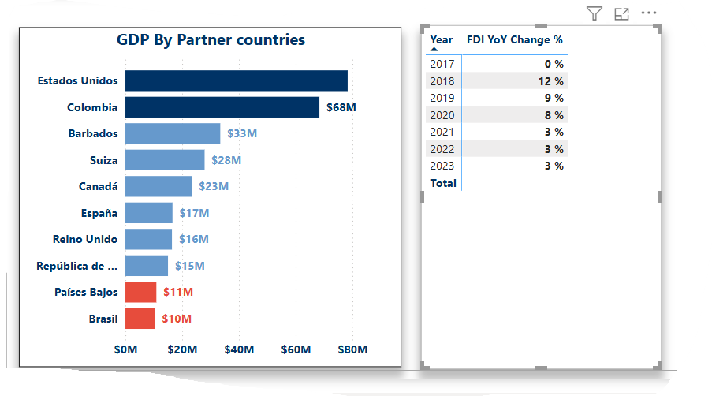
United States and Colombia Are Leading Investment Partners
The Story behind the data shows:
The United States is Panama’s top investment partner, with the largest share of FDI with $78million
Colombia follows closely behind, contributing a significant $68 million.
Other key contributors include Barbados, Switzerland, and Canada, showing diversified investor interest.
Countries like the Netherlands and Brazil show lower but notable levels of investment, signaling potential for growth.
FDI trends over the years:
Panama saw a surge in FDI growth in 2018 (12%) and 2019 (9%).
Growth has leveled out to a steady 3% annually from 2021 to 2023 — a sign of stabilization and consistent investor confidence.
Panama’s international investor network is strong, especially with partners in North and Latin America. These existing ties can open doors for cross-border partnerships, regional expansion, and easier market entry. It’s also a sign that Panama is viewed as a safe and reliable place to invest.

Slide 11
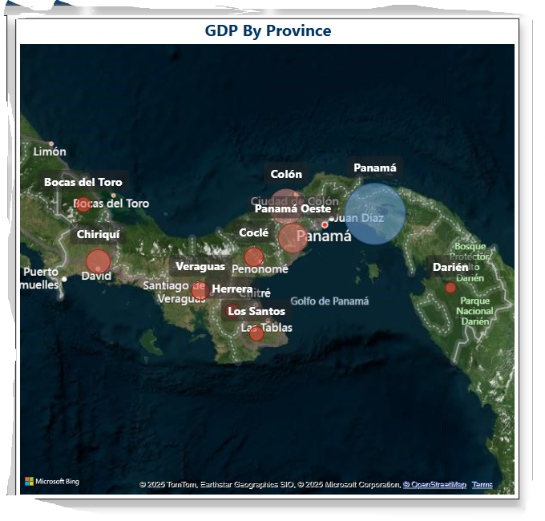
Panama Province and Colón Are Economic Focal Points
Data Insight:
Panama Province: GDP > $238 million; strong urban infrastructure and workforce availability.
Colón: Home to the Free Trade Zone; GDP > $65 million; strategic location for logistics and trade.
Both provinces are above national economic averages.
Headquarter in Panama City to access talent and markets; leverage Colón’s logistics ecosystem for efficient regional operations.

Slide 12

Where Dajcom Should Focus
Sector Attractiveness vs. Fit with Dajcom
Best focus
Logistics
Retail/Commerce
Telecom/ICT
Partnership areas
Agri-processing
Local manufacturing
Avoid/monitor Sectors with low or poor growth.

Slide 13
Opportunities and Risks
Opportunity | Risk | What We Can Do
Strong logistics system | Overdependence on Canal-related sectors | Include other markets like food retail
Growing investment in key sectors | Uneven growth across regions | Focus on Panamá, Colón, Chiriquí
Great trade location | Rules and regulations may change | Work with local legal experts
Growing middle class | High import costs | Mix imports with local goods

Slide 14
Strategic Recommendations
Where to Play:
Provinces: Panamá (HQ), Colón (logistics), Chiriquí (agriculture)
Sectors: Logistics, Retail, Agri-processing
How to Win:
Start with logistics-first model
Build local partnerships in farming and retail
Use data and technology to reach more customers
What to Expect:
Growth in 2–3 years
Synergy between trade, logistics, and retail
Long-term position in a stable market

Slide 15
Timeline – Step-by-Step Plan
Phase 1: Setup (6 months)
Find locations
Sign legal/logistics partnerships
Phase 2: Pilot (Year 1)
Start operations in 2 cities (Panamá Province)
Track results, adjust as needed
Phase 3: Expand (Year 2+)
Grow into Colón and Chiriquí
Add digital retail and farm partnerships

Slide 16
Metric | Value
Panama GDP growth rate | 5% per year
Top sector (Logistics) growth | 12–15%
FDI growth in key sectors | 10–14%
 | Data Sources: INEC Panama Delivery Options for Dajcom Board: Executive Slide Deck (20 slides) Excel Workbook (calculations and KPIs) Power BI Dashboard (filter by region, sector) One-Page Summary for Executives

